Slide 1
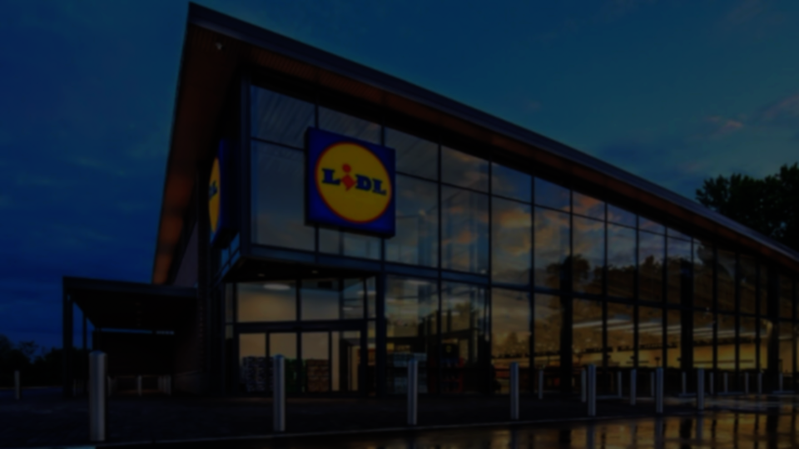
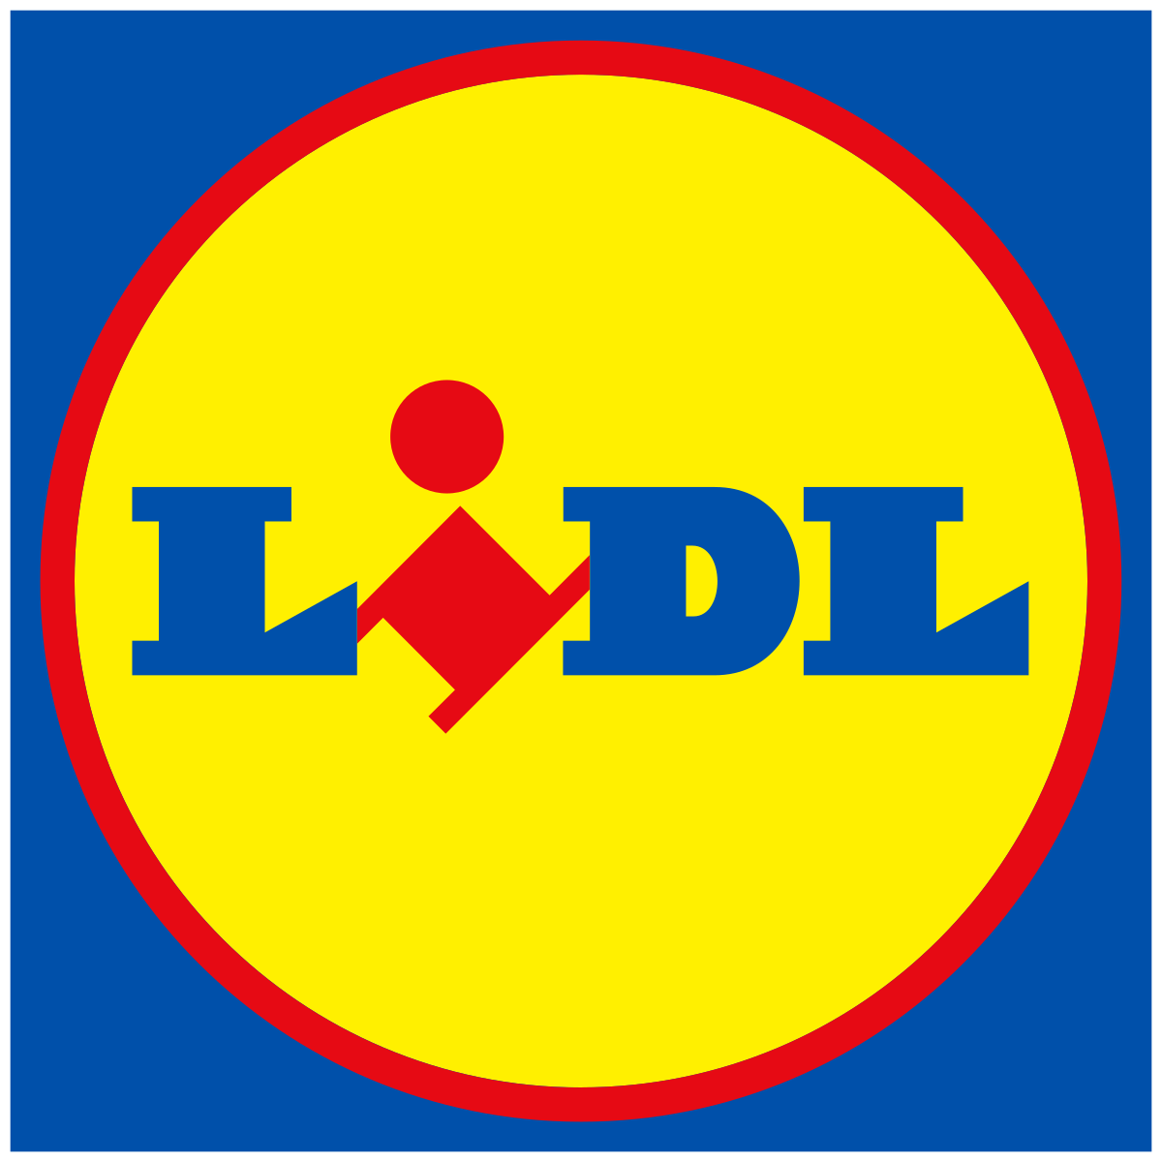
















Lidl Analytics- Management Summary Dashboard
Expansion of the candy assortment - private brand
WINNERS & LOSERS
CHARACTERISTICS
CHARACTERISTICS
CORRELATION
BEST COMBINATIONS
PREDICTION
RECOMMENDATION

Slide 2

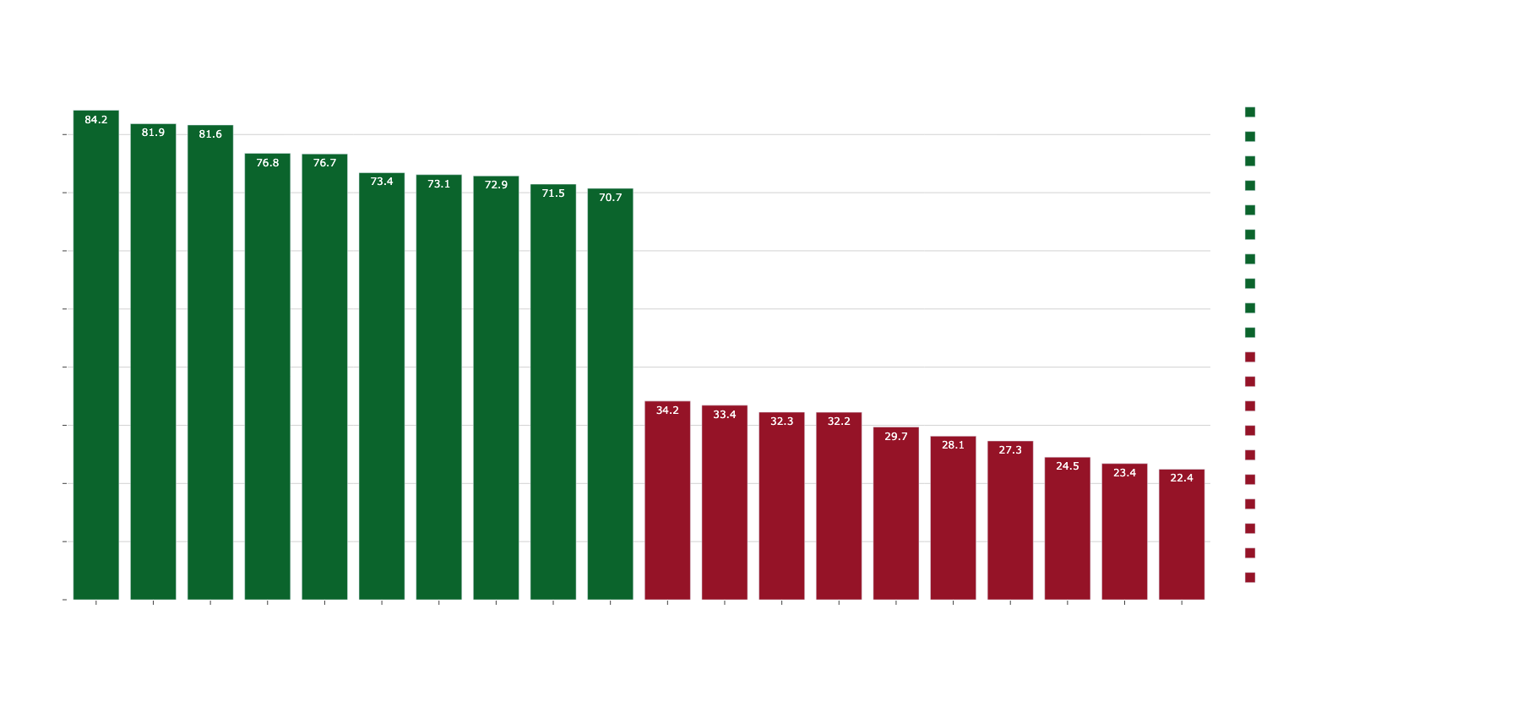
TOP TEN & WORST TEN
BEST is Reese‘s Peanut Butter cup & WORST is Nik L Nip !

Slide 3


GOOD INGREDIENTS
Median [1]:
chocolate: 60.8
caramel: 60.2
peanutyalmondy: 70.1
Products containing chocolate, caramel or peanutyalmondy as ingredients achieve BETTER winpercentages !

Slide 4

BAD INGREDIENTS
Median [0]:
fruity: 56.5
hard: 52.6
pluribus: 52.3
Products beeing fruity, hard or pluribus achieve WORSE winpercentages !

Slide 5
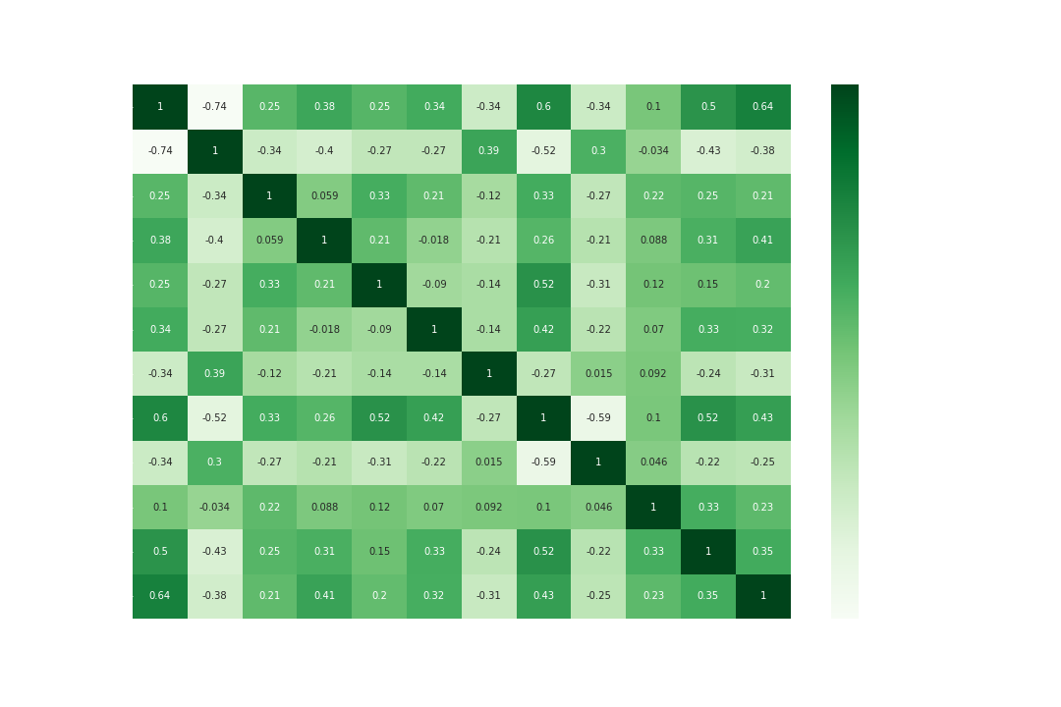

CORRELATION
Chocolate and winpercent have the largest correlation
Bar and winpercent, caramel and winpercent and peanutyalmondy and winpercent also are correlated
Careful! bar and chocolate are also correlated
confirms our previous findings

Slide 6

BEST COMBINATIONS
chocolate | 0 |  | 1
peanutyalmondy | 0 | 1 | 0 | 1
winpercent | 42,459 | 34,85721 | 57,28204 | 68,50379
chocolate | 0 |  |  | 1
peanutyalmondy | 0 |  | 1 | 0 |  | 1
caramel | 0 | 1 | 0 | 0 | 1 | 0 | 1
winpercent | 43,1196 | 35,52263 | 34,85721 | 53,57792 | 66,80694 | 69,88088 | 64,37253
chocolate | 0 |  | 1
caramel | 0 | 1 | 0 | 1
winpercent | 42,74404 | 35,52263 | 59,01224 | 66,07662
peanutyalmondy | 0 |  | 1
caramel | 0 | 1 | 0 | 1
winpercent | 46,2571 | 55,43083 | 63,51294 | 64,37253
chocolate and peanutyalmondy but without caramel is the best combination

Slide 7
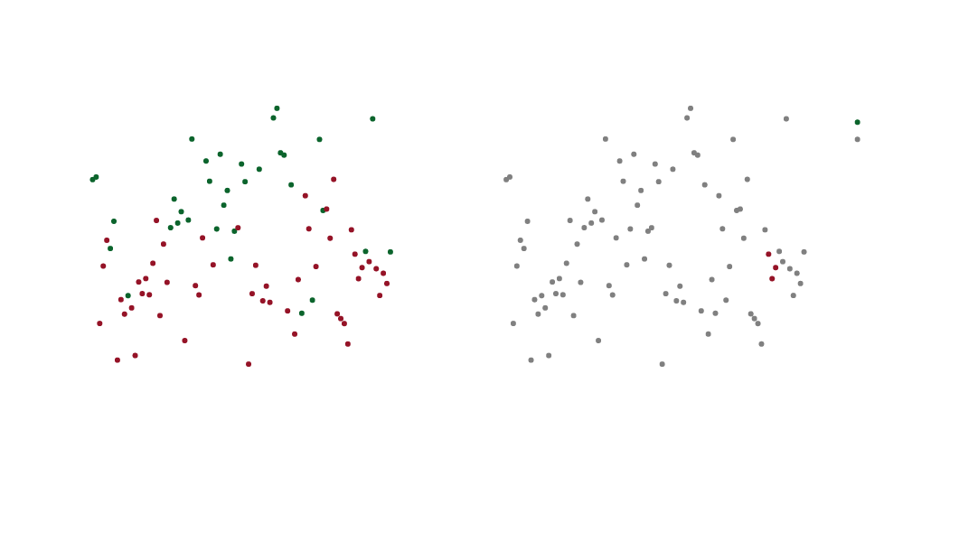
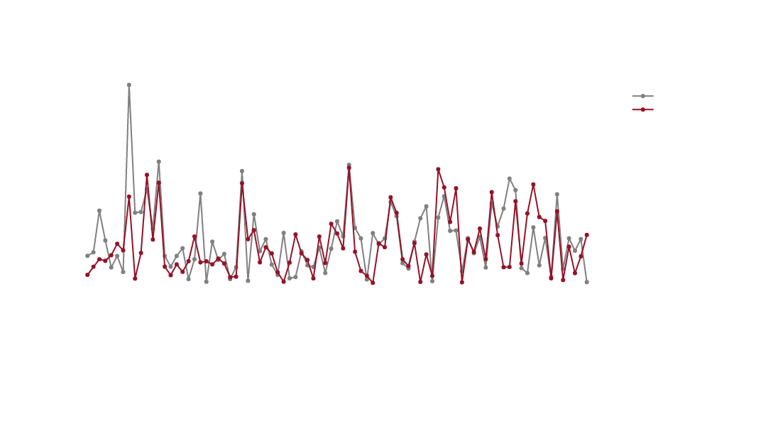
PREDICTION
can classify if a candy has chocolate as ingredient with 90% accuracy
can predict winpercent a candy will achieve
with chocolate: r2: 0.46. mse: 108.2
without chocolate: r2: 0.04 mse: 191

Slide 8
RECOMMENDATION
SUMMARY (WHAT WE FOUND):
chocolate, peantuyalmondy and caramel are the most important characteristics to achieve high winpercentage
(espacially the combination of chocolate and peanutyalmondy)
fruity, hard, pluribus are often triggers for a worse winpercentage
FINALLY:
produce a candy in private label that contains the good characteristics just mentioned. A perfect example which represents this best would be Reese's Peanut Butter cup.

